Slide 1

Data Mining – Meeting 4
Roi Yehoshua
Partially based on slides of Noam Koenigstein
The Open University

Slide 2
Agenda
C4.5, CART Algorithms
Overfitting problem
Decision Tree Pruning (Unit 6)
Classification Accuracy Measures

Slide 3
C4.5 ALGORITHM
C4.5 is an an extension of Quinlan's earlier ID3 algorithm.
C4.5 made a number of improvements to ID3:
Handling both continuous and discrete attributes
Handling training data with missing attribute values. Missing attribute values are simply not used in gain and entropy calculations.
Pruning trees after creation
Uses gain ratio instead of information gain
J48 is an open source Java implementation of the C4.5 algorithm in the Weka data mining tool.

Slide 4
Gain Ratio
The Information Gain of ID3 is biased toward test with many outcomes.
Consider the case of having product_ID or Date as an attribute…
C4.5 is a successor of ID3 that uses an extension to information gain known as gain ratio
The gain ratio “punishes” the multi-valued attributes via dividing their information gain by the Split Information
The Split Information represents the entropy of the tested attribute (in contrast to the entropy of the target attribute)

Slide 5


Gain Ratio
At every stage we compute both the information gain, and the split information
This value represents the potential information generated by splitting the dataset D into v partitions
The gain ration is defined as:
The attribute with the maximum gain ratio is selected as the splitting attribute

Slide 6
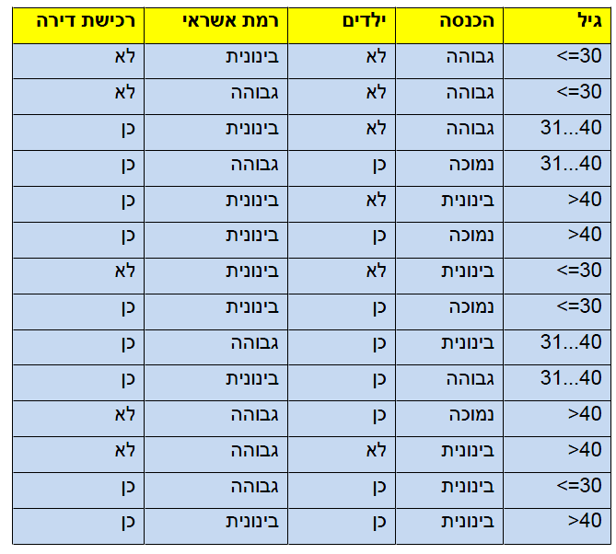
Gain Ratio Example
gain(income) = 0.029
gain_ratio(income) = 0.029/1.556 = 0.0186

Slide 7
CART ALGORITHM
The CART algorithm is based on Classification and Regression Trees by Breiman et al (1984).
Uses only binary splits
Uses Gini index
A CART tree is a binary decision tree that is constructed by splitting a node into two child nodes repeatedly, beginning with the root node that contains the whole learning sample.

Slide 8
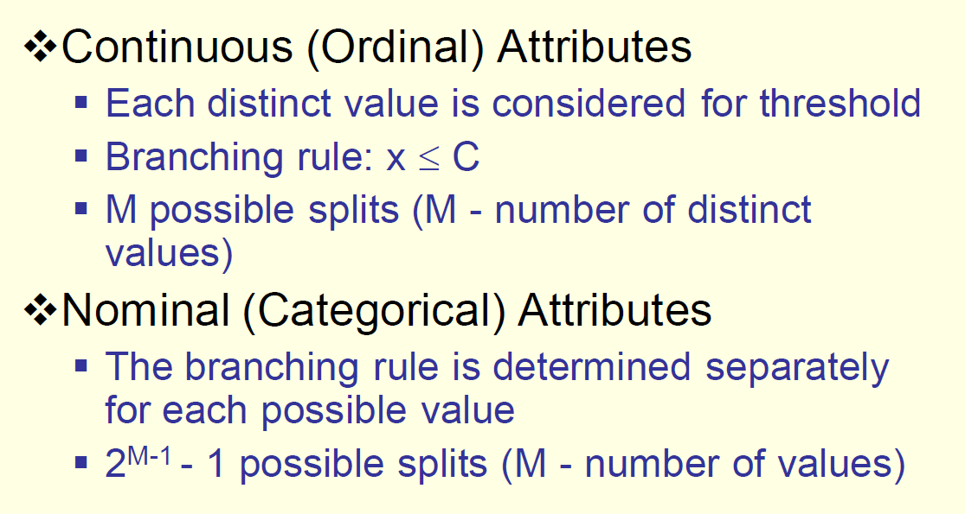
CART: Binary Splitting Criteria

Slide 9

Gini Index
Used in the CART algorithm (classification and regression tree)
Instead of entropy we consider “impurity”,
Gini impurity is a measure of how often a randomly chosen element from the set would be incorrectly labeled if it were randomly labeled according to the distribution of labels in the subset.

Slide 10
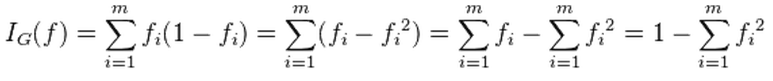
Gini Index
let f_{i} be the fraction of items labeled with value i in the set.
Then the gini index is:

Slide 11


CART Using Gini
CART is based on binary rules
For a discrete value, all possible partitions into two sets (except the empty set) are considered. How many possibilities?
The Gini index of D given a partition A is:
The reduction in “impurity” is:

Slide 12
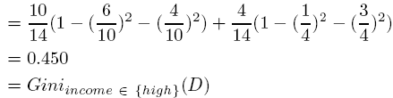
Gini Index Example
Ex. D has 9 tuples in buys_computer = “yes” and 5 in “no”
Suppose the attribute income partitions D into 10 in D₁: {low, medium} and 4 in D₂
but gini_{{medium,high}} is 0.30 and thus the best since it is the lowest

Slide 13
Comparing Attribute Selection Measures
The three measures, in general, return good results but
Information gain:
biased towards multivalued attributes
Gain ratio:
tends to prefer unbalanced splits in which one partition is much smaller than the others
Gini index:
biased to multivalued attributes
tends to favor tests that result in equal-sized partitions and purity in both partitions

Slide 14
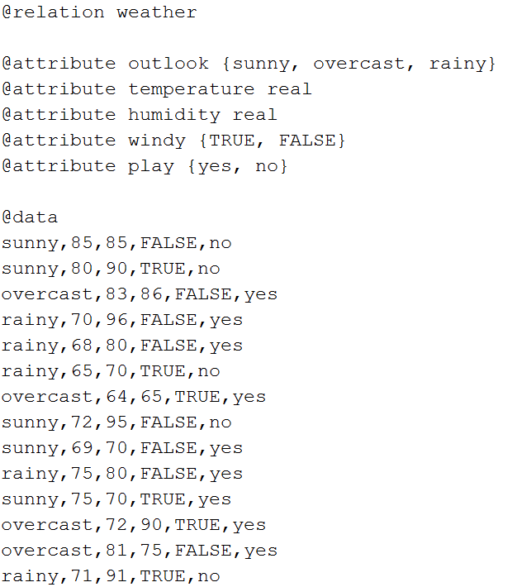
Decision Tree In Weka Demo Weather.arff

Slide 15

Decision Tree In Weka Demo
Run Weka
Click the Explorer button

Slide 16
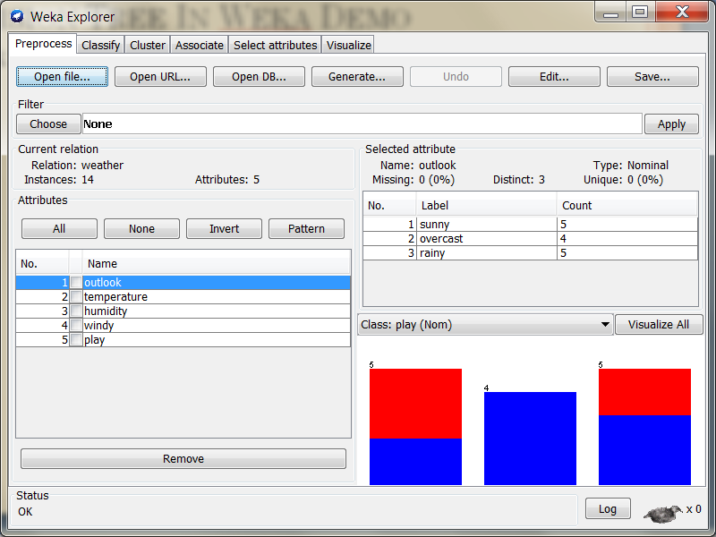
Decision Tree In Weka Demo
Click Open File… button and choose weather.arff

Slide 17
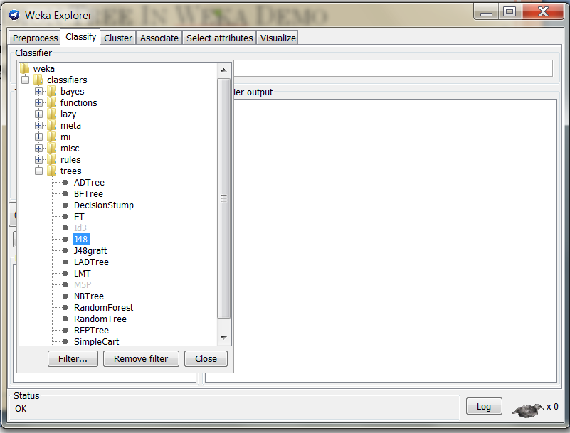
Decision Tree In Weka Demo
Move to Classify tab and for the Classifier choose trees – J48

Slide 18
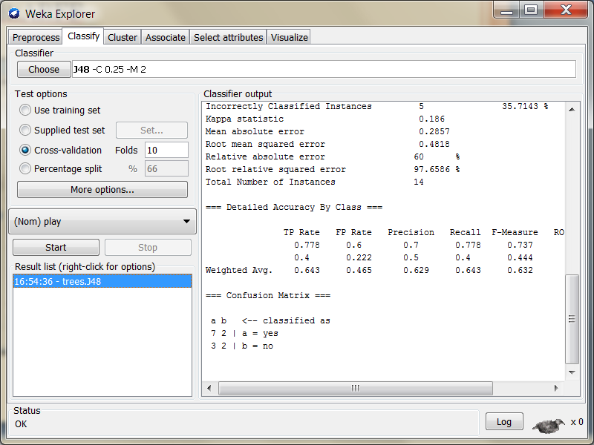
Decision Tree In Weka Demo
Click Start

Slide 19
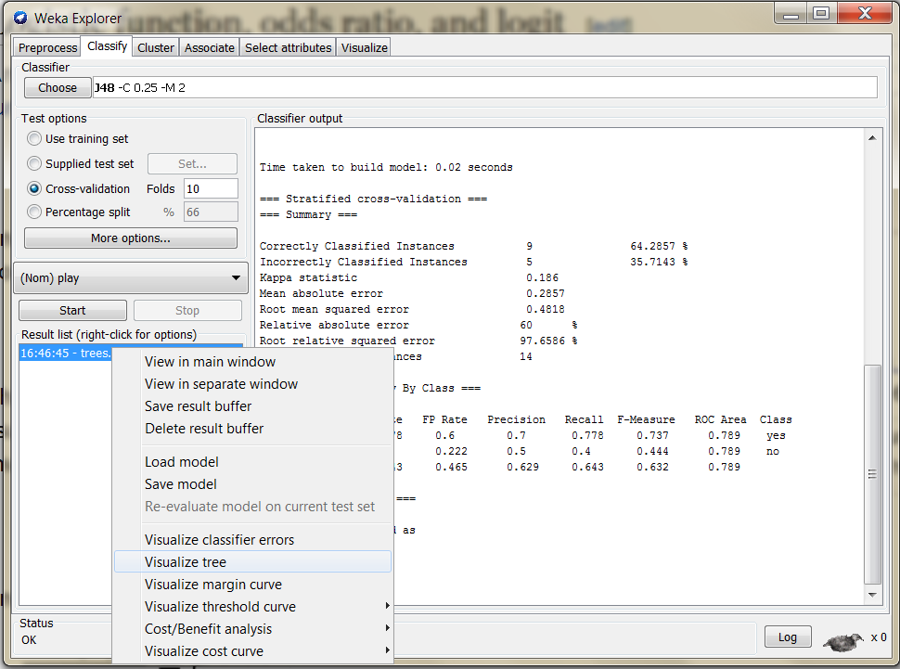
Decision Tree In Weka Demo
To see the tree right-click on the result in the Results list pane and choose the Visualize tree option

Slide 20
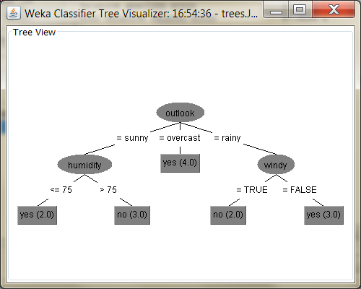
Decision Tree

Slide 21
Evaluating the Accuracy of a Classifier or Predictor
Use only the training data:
You have 100 labeled data
Weka will take 100 labeled data
It will apply an algorithm to build a classifier from these 100 data
It applies that classifier again on these 100 data
It provides you with the performance of the classifier (applied to the same 100 data from which it was developed)

Slide 22
Decision Trees From A Graphical Perspective
How does the attributes space look like?
R1>C
R2
R2>K
Blue
Red
Blue
K
C
R1

Slide 23
Decision Trees From A Graphical Perspective
R1>C
What if we add noise?
R2>K
R1<L
R2
R1<N
R2>P
R1<L
R1<L
K
R1<A
R1<F
R1<B
R1<S
C
R1

Slide 24
Avoiding Overfitting
Complicated trees may overfit the data!
We want to limit the trees complexity

Slide 25
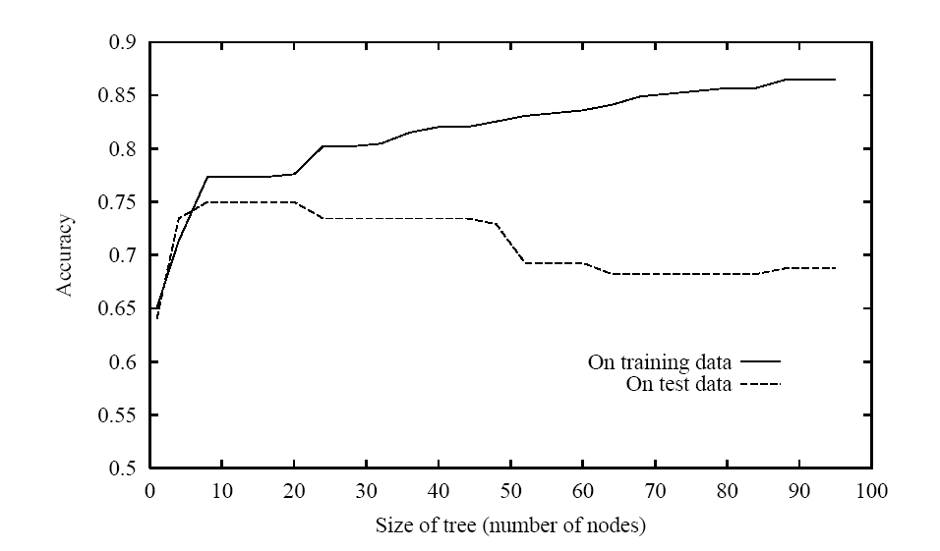
Overfitting In Decision Tree Learning
(Source: Mitchell, T.M., Machine Learning, McGraw-Hill, 1997)

Slide 26
Evaluating the Accuracy of a Classifier or Predictor (Cont.)
Cross-validation (k-fold, where k = 10 is most popular)
Randomly partition the data into k mutually exclusive subsets, each approximately equal size
At i-th iteration, use D_{i} as test set and others as training set
The advantage of this method is that all observations are used for both training and validation, and each observation is used for validation exactly once
Leave-one-out: k folds where k= # of tuples, for small sized data
Stratified cross-validation: folds are stratified so that class dist. in each fold is approx. the same as that in the initial data

Slide 27
Running Weka Using 10-Fold Cross-Validation
Weka takes 100 labeled data
It produces 10 equal sized sets. Each set is divided into two groups: 90 labeled data are used for training and 10 labeled data are used for testing
It produces a classifier with an algorithm from 90 labeled data and applies that on the 10 testing data for set 1
It does the same thing for set 2 to 10 and produces 9 more classifiers
It averages the performance of the 10 classifiers produced from 10 equal sized (90 training and 10 testing) sets

Slide 28
Running Weka Using 10-Fold Cross-Validation
The models which are created for the cross-validation fold sets are all discarded after the performance measurements have been carried out and averaged
The resulting model is always based on the full training set, regardless of your test options

Slide 29
Using Classifier On Test Sets In Weka
First split your database file into two files for training and for test (outside of Weka)
Run your classifier on the training set
Right-click the result and choose save model option

Slide 30
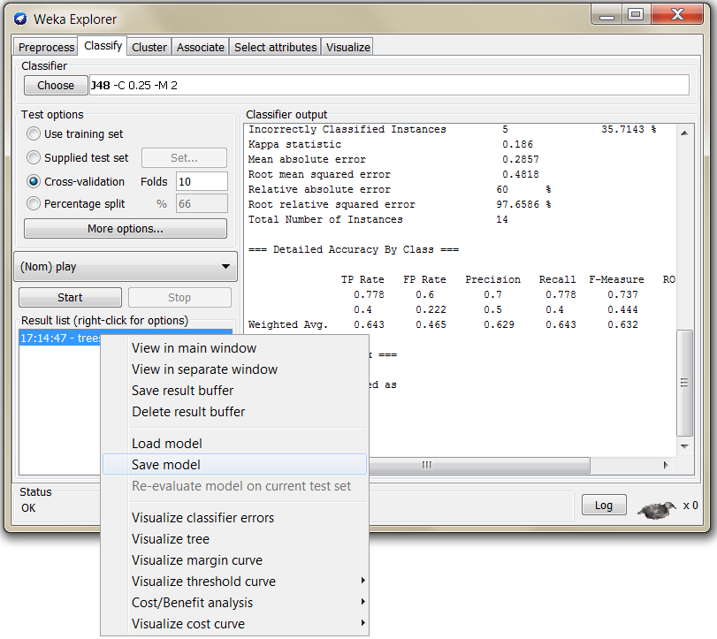
Using Classifier On Test Sets In Weka

Slide 31
Using Classifier On Test Sets In Weka
Now Click the Set… button next to Test options – Supplied test set and choose your test set file
Right-click the result and choose re-evaluate model on current test set

Slide 32
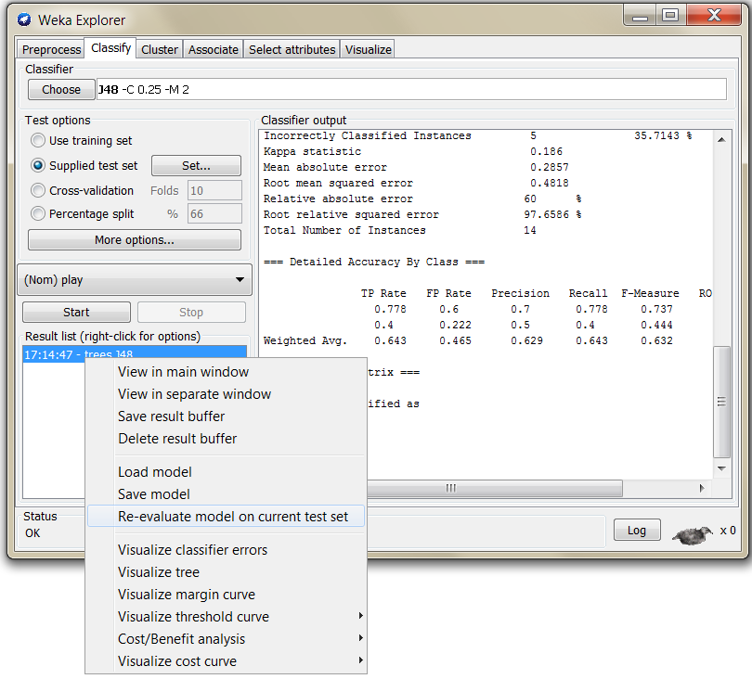
Using Classifier On Test Sets In Weka

Slide 33
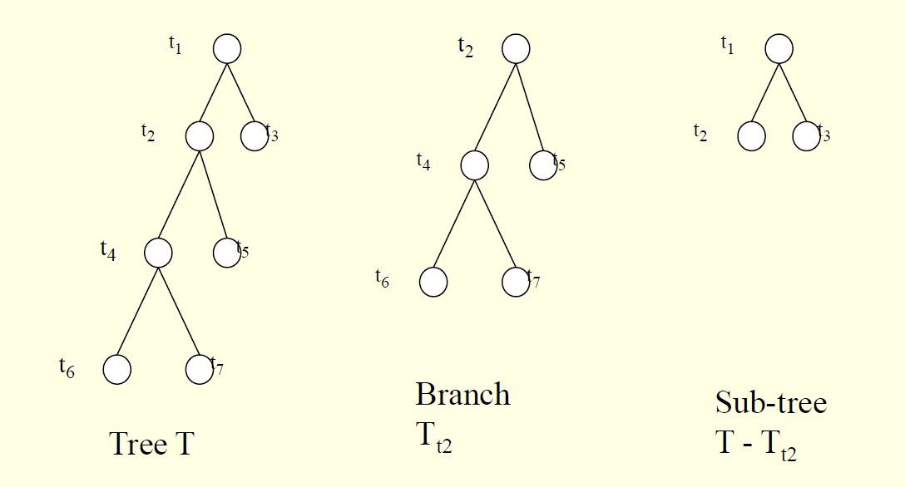
Pruning Trees

Slide 34
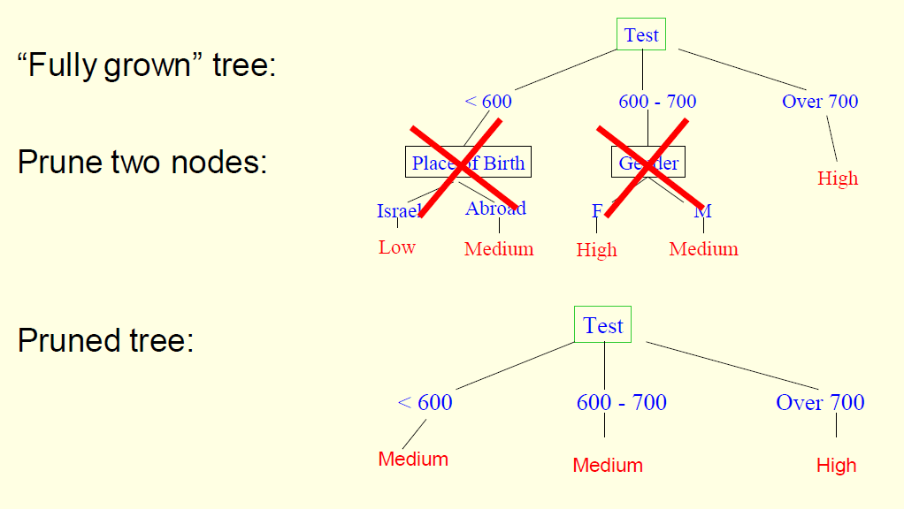
Pruning Example

Slide 35
Pruning
Two approaches to avoid overfitting
Prepruning: Halt tree construction early—do not split a node if this would result in the goodness measure falling below a threshold
Difficult to choose an appropriate threshold
Postpruning: Remove branches from a ―fully grown tree—get a sequence of progressively pruned trees
Use a set of data different from the training data to decide which is the ―best pruned tree

Slide 36
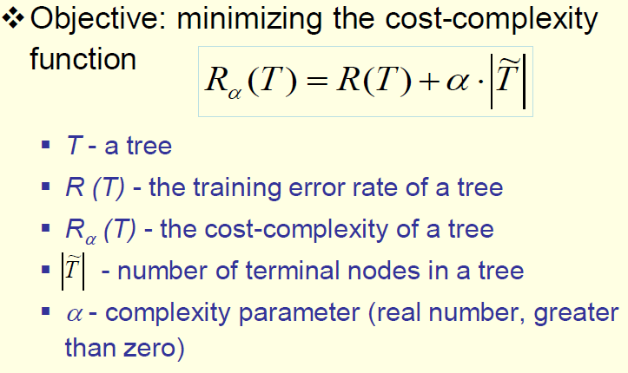

Pruning

Slide 37
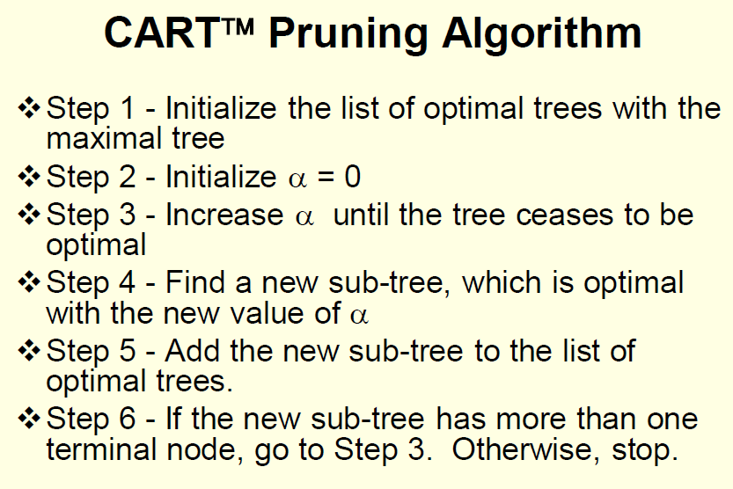

Slide 38
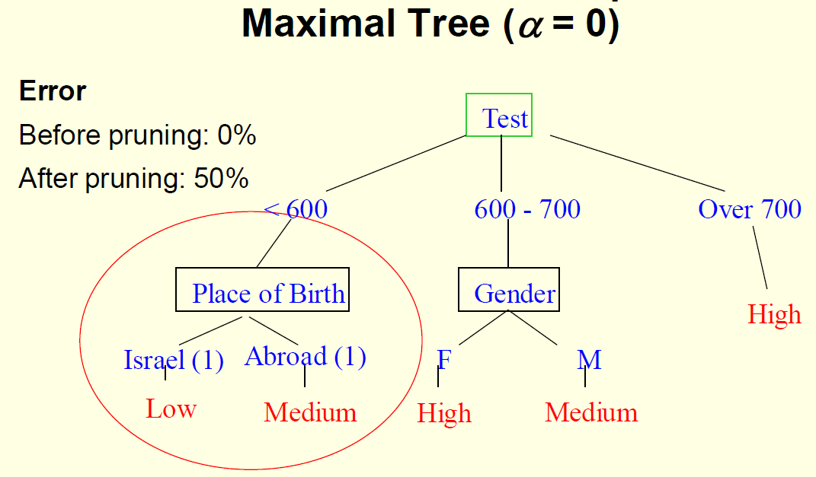
Cart Pruning Example

Slide 39
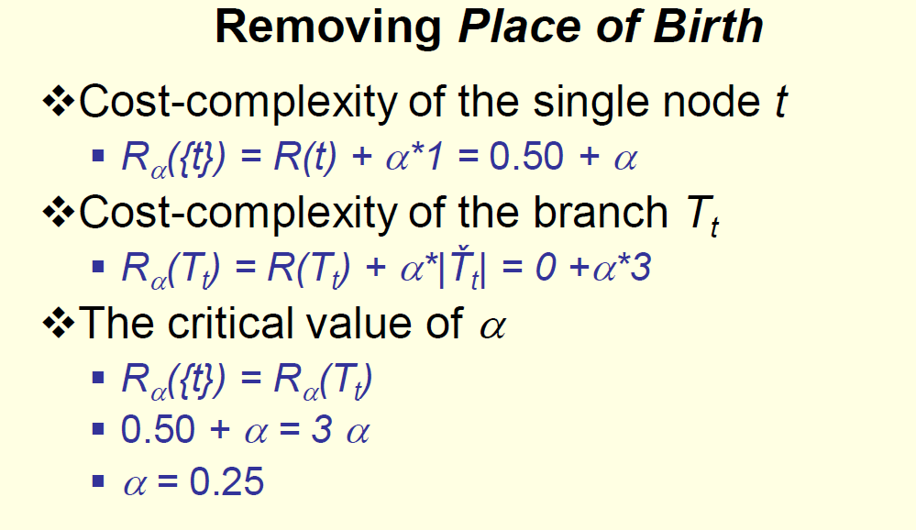
Cart Pruning Example

Slide 40
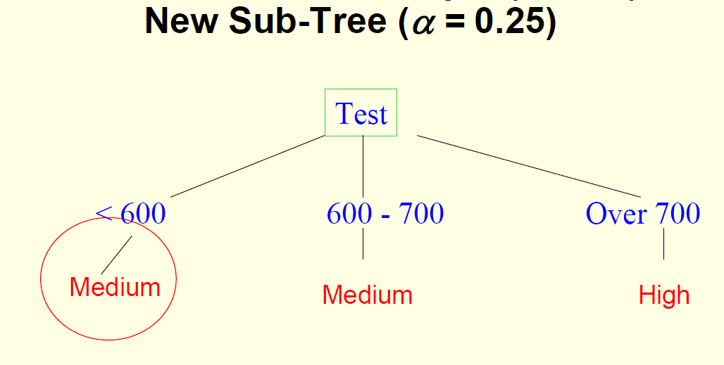
Cart Pruning Example

Slide 41
And Then What?
Go on the list of trees, and find the best one using a validation dataset
Once the best model was found, set alpha to its appropriate value.
Rebuild again using that alpha and the validation dataset

Slide 42
Classification – Accuracy Estimation
Estimate accuracy of the model
The known label of training / test sample is compared with the classified result from the model
Training Accuracy Rate
The percentage of training set samples that are correctly classified by the model
Testing Accuracy Rate
The percentage of test set samples that are correctly classified by the model
Test set is independent of training set, otherwise over-fitting will occur
If the accuracy is acceptable, use the model to classify data tuples whose class labels are not known
42

Slide 43
Classifier Accuracy Measures
 | C₁ | C₂
C₁ | True positive | False negative
C₂ | False positive | True negative
classes | buy_computer = yes | buy_computer = no | total | recognition(%)
buy_computer = yes | 6954 | 46 | 7000 | 99.34
buy_computer = no | 412 | 2588 | 3000 | 86.27
total | 7366 | 2634 | 10000 | 95.52
Accuracy of a classifier M, acc(M): percentage of test set tuples that are correctly classified by the model M
Error rate (misclassification rate) of M = 1 – acc(M)
Given m classes, CM_{i,j}, an entry in a confusion matrix, indicates # of tuples in class i that are labeled by the classifier as class j
43

Slide 44
Classifier Accuracy Measures
Alternative accuracy measures (e.g., for cancer diagnosis)
sensitivity = t-pos/pos /* true positive recognition rate */
specificity = t-neg/neg /* true negative recognition rate */
precision = t-pos/(t-pos + f-pos)
accuracy = sensitivity * pos/(pos + neg) + specificity * neg/(pos + neg)
Sensitivity = TP/P = 6954 / 7000 = 99.34%
Specificity = TN/N = 2588 / 3000 = 86.27%
Precision = TP/(TP+FP) = 6954 / 7366 = 94.41%
Accuracy = (TP+TN)/(TP+FP+TN+FN) = 9542 / 10000 = 95.42%
classes | buy_computer = yes | buy_computer = no | total | recognition(%)
buy_computer = yes | 6954 | 46 | 7000 | 99.34
buy_computer = no | 412 | 2588 | 3000 | 86.27
total | 7366 | 2634 | 10000 | 95.52
44

Slide 45
Model Selection: ROC Curves
ROC (Receiver Operating Characteristics) curves: for visual comparison of classification models
Originated from signal detection theory
Shows the trade-off between the true positive rate and the false positive rate
The area under the ROC curve is a measure of the accuracy of the model
Rank the test tuples in decreasing order: the one that is most likely to belong to the positive class appears at the top of the list
The closer to the diagonal line (i.e., the closer the area is to 0.5), the less accurate is the model
Vertical axis represents the true positive rate
Horizontal axis rep. the false positive rate
The plot also shows a diagonal line
A model with perfect accuracy will have an area of 1.0
45

Slide 46
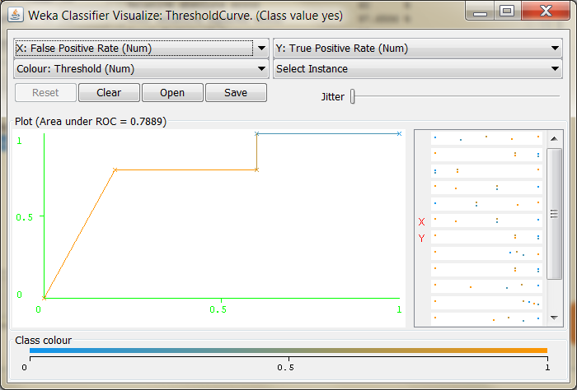
Visualizing ROC Curve In Weka
After running the classifier, right-click on the result and choose Visualize threshold curve

Slide 47
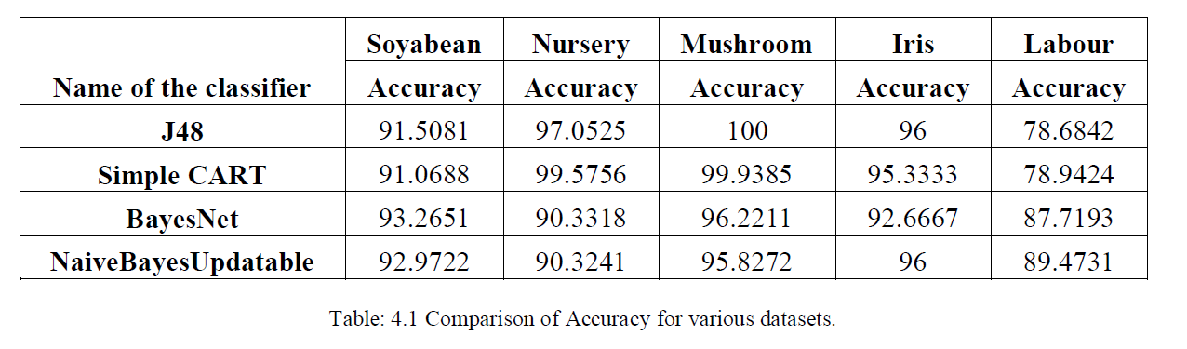
Comparing Classifiers On Data Sets
Kharche, Deepali, K. Rajeswari, and Deepa Abin. "Comparison of different datasets using various classification techniques with weka." International Journal of Computer Science and Mobile Computing 3.4 (2014): 389-393.

